Slide 1
Distracted Driver Survey Results & Recommendations
C+C (with SurveyUSA)
April 18, 2017

Slide 2
Top-line Research Findings
Distracted Driving Survey

Slide 3
Research Overview
SurveyUSA phone survey
Conducted March 7-16, 2017
Females age 16-34
Sample size: 1,000 (847 drivers)
WA state

Slide 4
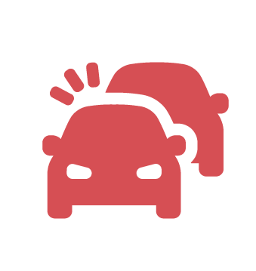
Agreement on Dangers
As Drivers:
96%
Agree that using a cell-phone while driving is dangerous
97%
Agree that typing on a cell phone while driving is dangerous
91%
Agree they may cause an accident if using their cell phone while driving

Slide 5
Agreement on Dangers
As Passengers:
Only 1%
Are "very comfortable" if the driver is texting
Only 2%
Are "very comfortable" if the driver is using the phone to check social media
Only 5%
Are "very comfortable" if the driver is driving with 1 hand while holding a phone with the other

Slide 6
But…does it translate to behavior?
96%
Have their phone on while driving
91%
Use their phone GPS to navigate
64%
Answer a ringing phone
59%
Use phone when stopped at a traffic light
51%
Make phone calls

Slide 7
But…does it translate to behavior?
48%
12%
9%
Read an incoming text message
Look at social media
Look at websites other than social media
34%
8%
Send a text message
Post to social media

Slide 8
Barriers
They think they are safe doing it.

Slide 9
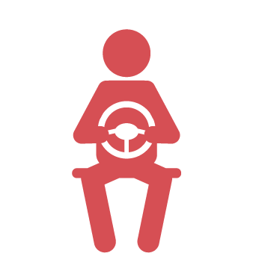
Barriers
81%
Say they can safely drive using a hands-free device that allows them to talk while keeping 2 hands on the wheel
55%
Say they can safely drive using just one hand on the steering wheel

Slide 10
Motivators…would stop using their cell phone while driving if:
98%
91%
89%
A passenger asked them to stop using their phone
Thought they might get a $136 traffic ticket
To model good behavior for their children
88%
If they knew that government statistics show you are 23 times more likely to crash
Notes:
Multitasking did not end up being as high of a top motivator as we expected – just 14% had FOMO, 28% (23% of moms) agree that they using a phone in the car helps me be more productive

Slide 11
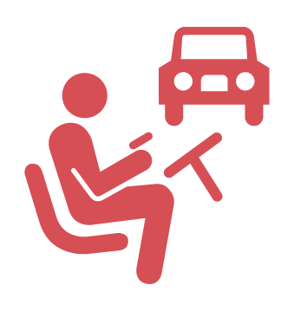
Motivators cont.
87%
Knew that studies show you miss half of what’s going on around you while driving
85%
Knew distraction was a factor in 30% of fatal crashes in WA state
82%
Knew it takes 27 seconds to restore your focus after ending a hands-free call on phone
82%
Knew it was illegal
66%
Knew friends & family disapproved

Slide 12
Recommendations
RESEARCH IN ACTION

Slide 13
Recommended targets
Target Audience: Moms of kids K-12
Target Behavior: Don’t hold or touch your phone (match the law)
Focus: Role-Modeling (when kids are in the car with them)

Slide 14
Rationale – Why Moms?
They score high on key indices used to select a target audience for a behavior change effort:
Size Audience is significant.
Moms of school age children (K-12) Estimate: 500,000 in WA state
Incidence Of “the problem behavior” is significant.
-44% reported looking at text messages while driving -31% reported sending text messages while driving
Notes:
624,768 households with children K-12.
500,000 Conservative estimate of number of moms with school age children (K-12)

Slide 15
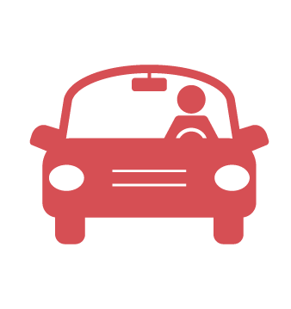
Rationale – Why Moms? Cont.
Concern with “the problem behavior” is significant
55% are concerned they might cause an accident using their cellphone while driving
95% want to model correct behavior for kids
95% are concerned about their safety and the safety of their passengers using the cellphone while driving
Impact Of the behavior change would be significant, given the focus on driving with passengers in the car
Ability To identify and reach through targeted media channels is strong

Slide 16
Mom-Specific Stats
Top Motivators:
84%
Passenger or child in car asks you to stop
79%
Hearing stories about collisions
59%
Knowing they’re 23x more likely to crash

Slide 17
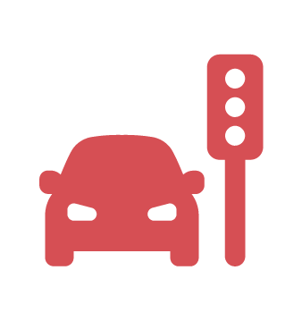
Mom-Specific Stats
Top Barriers:
65%
Social norm: think “everyone does it”
Safety Perception:
61%
Say they only use at traffic lights
68%
Comfortable when others use at a light

Slide 18
Next Steps
Determine campaign timing
Draft social marketing brief
Develop campaign creative concepts
Develop marketing plan
For full survey results, click here.

