Slide 1
Washington’s Traffic Safety Culture
About driving under the influence of cannabis and alcohol (DUI-CA)

Slide 2
Overview
Target Zero Culture
Washington’s Current Culture on Driving Under the Influence of Cannabis and Alcohol
What YOU Can Do

Slide 3
What is Culture?

Slide 4
Culture
Shared values, assumptions, and beliefs
of a group of people
that influence their behaviors

Slide 5
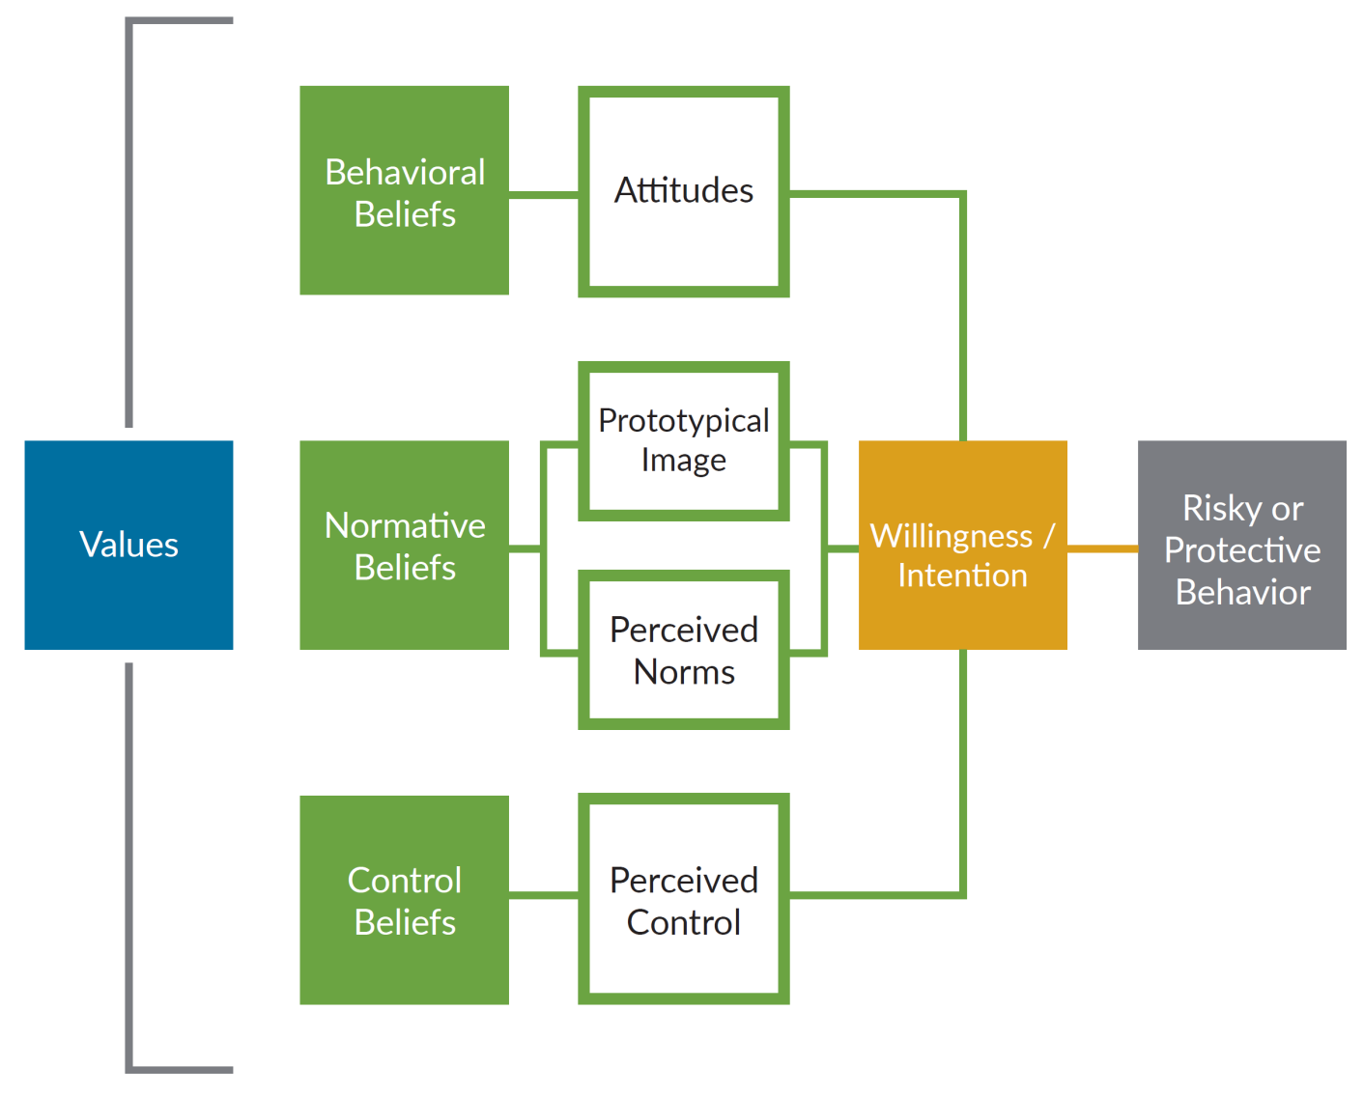
Behavior Model

Slide 6
Concerns About Impaired Driving
Alcohol and drug impaired driving is the leading contributing factor in Washington fatal crashes.
Poly-drugged driving a factor in one-quarter of Washington’s crashes
Grondel, D.T., Hoff, S., and Doane, D., (2018). Marijuana Use, Alcohol Use, and Driving in Washington State: Emerging Issues With Poly-Drug Use on Washington Roadways. Washington Traffic Safety Commission.

Slide 8
Concerns About Impaired Driving
Cannabis use is increasing.
Past year cannabis use by adults (age 18+) in Washington has increased by 85% in the past 9 years (2008 to 2017).¹
2017
2008
Weekend, nighttime drivers testing positive for THC increased by 50% from 2007 to 2014.²
2014
2007
Went from 12.6% in 2008-09 to 23.2% in 2016-17 (SAMHSA, Center for Behavioral Health Statistics and Quality, National Survey on Drug Use and Health, 2018).
Berning, A., R. Compton, and K. Wochinger, “Results of the 2013–2014 National Roadside Survey of alcohol and drug use by drivers.” Traffic Safety Facts Research Note. Report No. DOT HS 812 118. Washington, DC: National Highway Traffic Safety Administration, (February 2015) pp. 1-5.

Slide 9
Concerns About Impaired Driving
People in Washington are driving after using cannabis.
In June 2014, 11% of weekend, night-time drivers reported they had driven within two hours of using cannabis at least once in the past 12 months.¹
By 2016, poly-drug drivers (including alcohol) involved in fatal crashes were
more than twice the number of alcohol-only drivers and
more than five times the number of cannabis-only drivers.²
SAMHSA, Center for Behavioral Health Statistics and Quality, National Survey on Drug Use and Health, 2002-2017.
Washington Traffic Safety Commission, Marijuana Use, Alcohol, Use and Driving in Washington State, April 2018.

Slide 10
Concerns About Impaired Driving
Driving under the influence of cannabis increases crash risk.
“There is substantial evidence of a statistical association between cannabis use and increased risk of motor vehicle crashes.”¹
A meta-analysis of 66 studies shows that the risk of being involved in a crash increases when using cannabis.²
Drivers under the influence of cannabis are more likely responsible for a fatal crash than non-intoxicated drivers.³
National Academies of Sciences, Engineering, and Medicine. 2017. The health effects of cannabis and cannabinoids: The current state of evidence and recommendations for research. Washington, DC: The National Academies Press.
Elvik, Rune, “Risk of Road Accident Associated with the Use of Drugs: A Systematic Review and Meta-Analysis of Evidence from Epidemiological Studies.” Accident Analysis & Prevention, Vol. 60 (November 2013) pp. 254–67.
Gadegbeku, Blandine, Emmanuelle Amoros, and Bernard Laumon, “Responsibility Study: Main Illicit Psychoactive Substances among Car Drivers Involved in Fatal Road Crashes.” Annals of Advances in Automotive Medicine. Association for the Advancement of Automotive Medicine. Scientific Conference, Vol. 55 (2011) pp. 293–300.

Slide 11
Traffic Safety Survey
Center for Health and Safety Culture to assess Washington’s Traffic Safety Culture About Driving Under the Influence of Cannabis and Alcohol (DUI-CA)
Understand the culture (shared values, attitudes, beliefs, and behaviors) of people who DUI-CA
Understand the culture of people who intervene to prevent someone from driving impaired

Slide 12
Traffic Safety Survey
Survey
870 participants ages 18-65 living in Washington
Statewide representative sample
DUI-CA defined as driving within 2 hours of using marijuana and alcohol
CAUTION: Driving after 2 hours since consuming cannabis and/or alcohol is NOT safe. Used as a standard survey question.

Slide 13
Traffic Safety Survey
CAUTION: Driving after 2 hours since consuming cannabis and/or alcohol is NOT safe.
Why 2 hours?
For survey purposes only
Easier to answer than longer time periods
Consistent with other surveys for comparison
Driving after consuming alcohol or marijuana is not safe…even after 2 hours. Multiple factors determine how quickly alcohol leaves the body. There is a lack of research for marijuana, since it stored in the fat, effects could last for days.

Slide 14
Traffic Safety Culture
Most adults in Washington are concerned about traffic safety and have strong protective beliefs.
Most are moderately or more concerned about safety on roads and highways
Most (74%) agree the only acceptable number of deaths and serious injuries on our roadways should be zero.
Most (91%) agree that it is the responsibility of the driver to comply with the laws of our roads.
Most (64%) agree that impairment begins with the first sip of alcohol.
Most (76%) agree that impairment begins as soon as you start consuming cannabis.

Slide 15
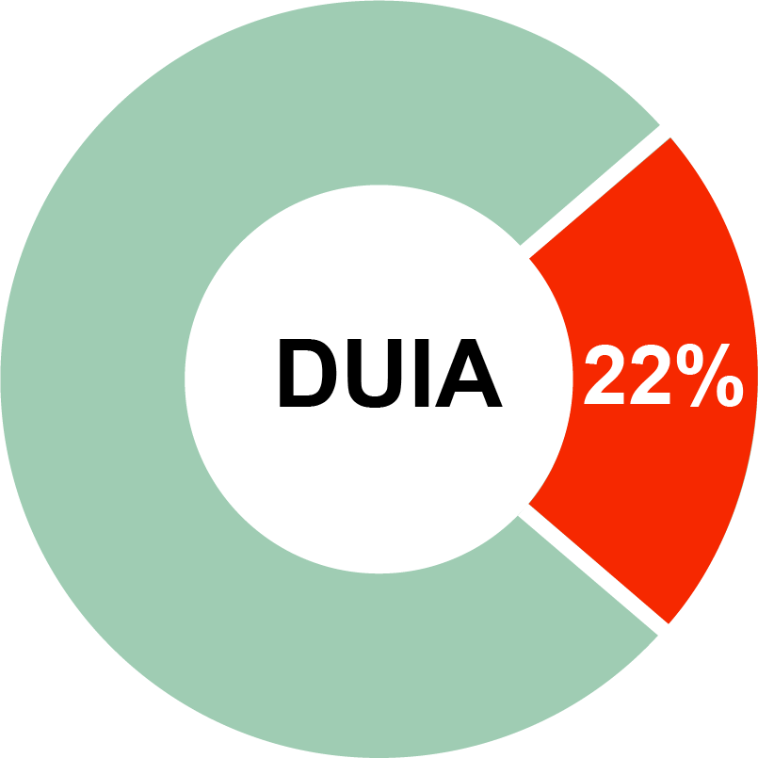
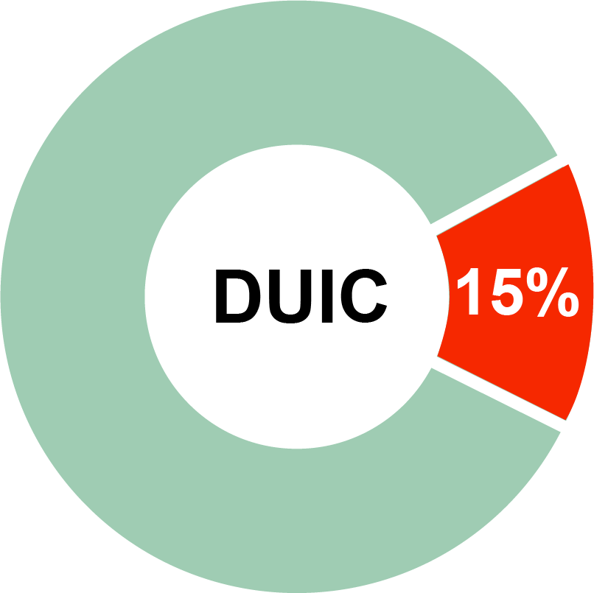
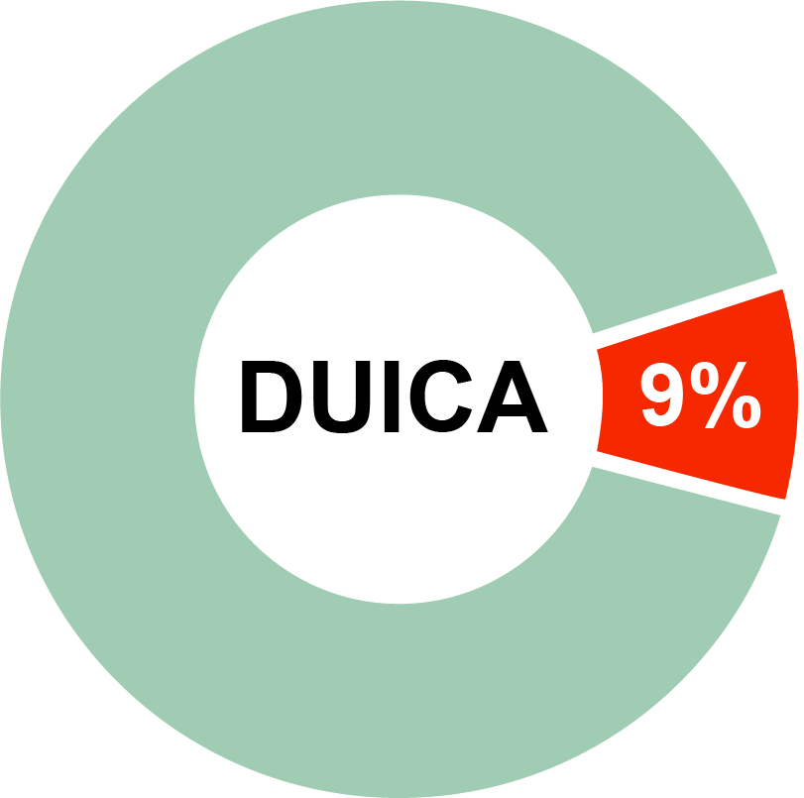
Traffic Safety Culture
Most adults in Washington don’t drive under the influence.
Self-Reported 12-month Driving Behaviors
78% don’t drive within 2 hours of consuming alcohol
85% don’t drive within 2 hours of consuming cannabis
91% don’t drive within 2 hours of consuming cannabis and alcohol
However, too many do thus creating significant risk to themselves and the general public.

Slide 16
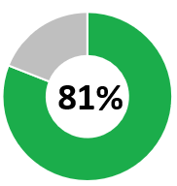
Traffic Safety Culture
Most adults in Washington (81%) have a NEGATIVE attitude about DUI-CA.
Those with a positive attitude are TWICE as likely to DUI-CA.
Those who do DUI-CA are:
More likely to believe that driving under the alcohol and cannabis improves their driving; and
Less likely to believe that they are at risk to be arrested or be in a crash.

Slide 17
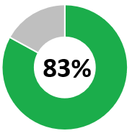
Traffic Safety Culture
Most adults (83%) believe it is UNACCEPTABLE to drive within two hours of consuming alcohol and cannabis.
Those who perceive DUI-CA is acceptable are more than 4.5 TIMES more likely to DUI-CA themselves.

Slide 18
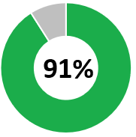
Traffic Safety Culture
Most adults (91%) DON’T drive within two hours of consuming alcohol and cannabis.
Those who perceive most people DUI-CA frequently are TWICE as likely to DUI-CA themselves.
Those who do DUI-CA perceive most adults in Washington do as well (when in fact, most do NOT)!

Slide 19
Traffic Safety Culture
People who DUI-CA may be using cannabis because they believe it “calms them down” and “sobers them up” when they have had too much to drink.
77% of those who DUI-CA are likely to feel anxious after drinking and use cannabis to calm down
52% of those who DUI-CA are likely to feel too impaired after drinking and then use cannabis to sober up
Using cannabis after drinking does NOT make it safer to drive.^{1,2,3}
National Academies of Sciences, Engineering, and Medicine. 2017. The health effects of cannabis and cannabinoids: The current state of evidence and recommendations for research. Washington, DC: The National Academies Press.
Elvik, Rune, “Risk of Road Accident Associated with the Use of Drugs: A Systematic Review and Meta-Analysis of Evidence from Epidemiological Studies.” Accident Analysis & Prevention, Vol. 60 (November 2013) pp. 254–67.
Gadegbeku, Blandine, Emmanuelle Amoros, and Bernard Laumon, “Responsibility Study: Main Illicit Psychoactive Substances among Car Drivers Involved in Fatal Road Crashes.” Annals of Advances in Automotive Medicine. Association for the Advancement of Automotive Medicine. Scientific Conference, Vol. 55 (2011) pp. 293–300.

Slide 20
Traffic Safety Culture
Bystander Intervention
Among adults in Washington in a situation to intervene, most (81%) take steps to prevent someone from driving impaired.
They do safe things like:
Arranging or providing a ride for the person;
Arranging for the person to stay where they are; or
Engaging someone else to help including being prepared to call 911 if the person drives

Slide 21
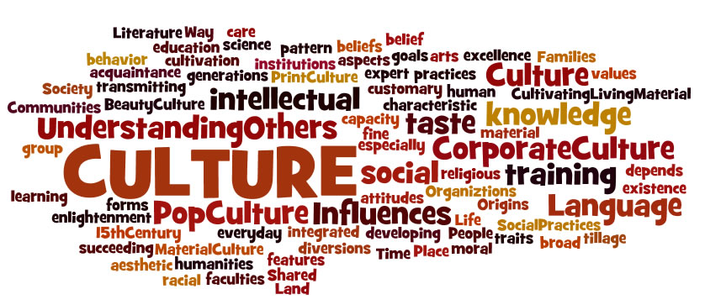
What YOU Can Do!
We CREATE our culture!
This Photo by Unknown Author is licensed under CC BY-SA-NC

Slide 22
What YOU Can Do!
Share and discuss these results.
Leverage the existing positive shared values, attitudes, and beliefs
Correct misperceptions
DUICA is NOT safe
Most people believe DUICA is unacceptable
Most people do NOT DUICA
Using cannabis after drinking does NOT make it safer to drive

Slide 23
What YOU Can Do!
Integrate accurate information into existing programs, strategies, and communications.
Clearly establish the existing positive shared values, attitudes, and beliefs.
Correct misperceptions
DUICA is NOT safe
Most people believe DUICA is unacceptable
Most people do NOT DUICA
Using cannabis after drinking does NOT make it safer to drive

Slide 24
What YOU Can Do!
Grow bystander engagement to prevent impaired driving.
Integrate SAFE bystander engagement practices into existing programs, strategies, and communications.
Do NOT promote disabling vehicles, allowing impaired people to walk, or the use of physical intervention.
Do promote safe strategies like:
arranging or providing a ride for the person;
having the person stay where they are; or
engaging others to help (including 911 if the person drives).

Slide 25
Questions or Comments

Slide 26
Name
Title
Contact Information

